Slide 1
Session 5

Slide 2
Content of session
01
02
Object Pooling
Global Scripts

Slide 3
Let’s talk about the previous jam
Before we start

Slide 4
01
Object Pooling

Slide 5
Object Pooling
What is Object Pooling ?

Slide 6
Object Pooling
Imagine firing 10000 bullets

Slide 7
Object Pooling
Definition: Object pooling is a design pattern where a set of pre-instantiated objects (e.g., bullets, enemies) are reused instead of being created and destroyed repeatedly.

Slide 8
Object Pooling
Why use Object Pooling ?

Slide 9
Object Pooling
Improves performance by reducing memory allocation and garbage collection.
Essential for games with frequent object creation/destruction (e.g., shooters, RPGs).

Slide 10
Object Pooling
When to use Object Pooling ?

Slide 11
Object Pooling
When you have many objects that are frequently spawned and destroyed.
When instantiation is expensive (e.g., complex objects with many nodes).

Slide 12
Object Pooling
Definition: Object pooling is a design pattern where a set of pre-instantiated objects (e.g., bullets, enemies) are reused instead of being created and destroyed repeatedly.
Why use it ? Improves performance by reducing memory allocation and garbage collection. Essential for games with frequent object creation/destruction (e.g., shooters, RPGs).
When to use it?: When you have many objects that are frequently spawned and destroyed. When instantiation is expensive (e.g., complex objects with many nodes).

Slide 13
Object Pooling
How Object Pooling works ?

Slide 14
Object Pooling
Pool Structure: A collection (e.g., array or dictionary) of inactive objects.
Lifecycle:
- Spawn: Take an object from the pool and activate it.
- Despawn: Deactivate the object and return it to the pool.
Visual: Flowchart showing the lifecycle of an object in the pool.

Slide 15

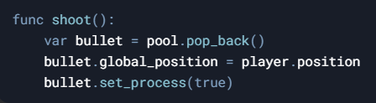
Object Pooling
Without pooling:
With pooling:

Slide 16
Object Pooling
Let’s try to make pooling

Slide 17
Object Pooling
Hands on

Slide 18
Object Pooling
what else can we add to the pooling (Advanced) ?

Slide 19
Object Pooling
Dynamic Pool Expansion: Automatically add more objects to the pool if it runs out.
Pool Cleanup: Remove unused objects from the pool after a certain time.
Generic Pooling: Create a reusable pooling system for any type of object.

Slide 20
02
Singletons & Autoload

Slide 21
Singletons
Singletons are a design pattern approach to construct one “single” instance of an object, most commonly to manage other objects.
Singletons in games are mostly used to store centralized data across different levels, such as
Game score, health, level, money etc.
Settings like audio and other preferences
Any Data that needs to persist between levels or be saved for later.

Slide 22
Autoload
Autoload is Godot’s implementation of singletons, where a script will be instanced once and used anywhere.
The Autoload script acts like a global object or instanced and can be accessed from anywhere in the project.

Slide 23
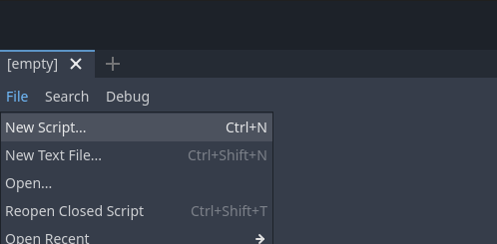
Autoload
To use autoloads, first we make a normal script.

Slide 24
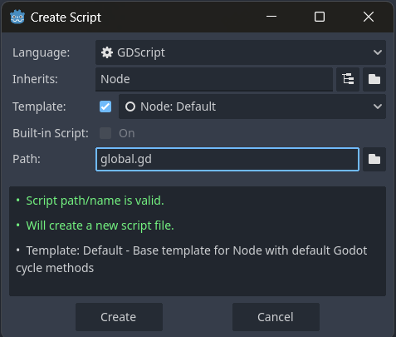

Slide 25
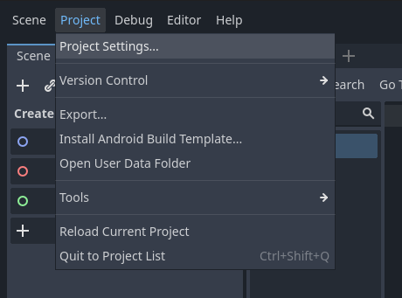
After that we need to add the script to the autoload section.
Go to projects -> project settings, and then choose the Autoload tab.

Slide 26
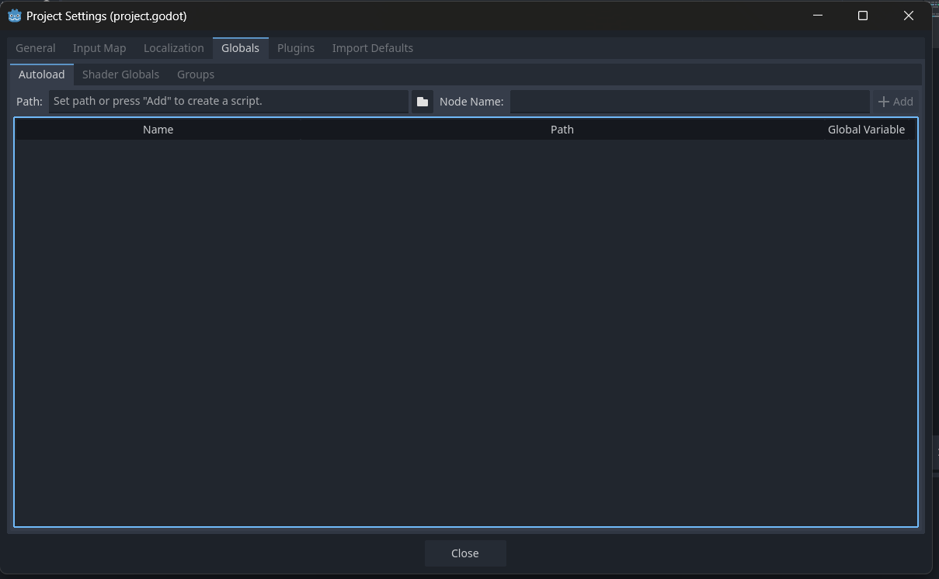
In the Autoload Tab, we click the folder button and choose the script we want to have as the autoload.

Slide 27
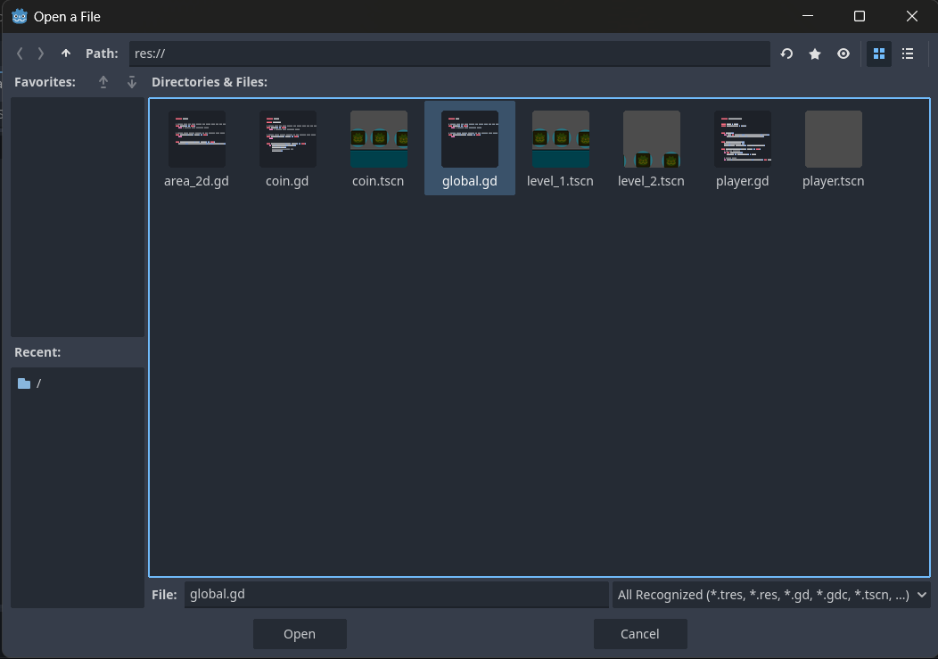

Slide 28
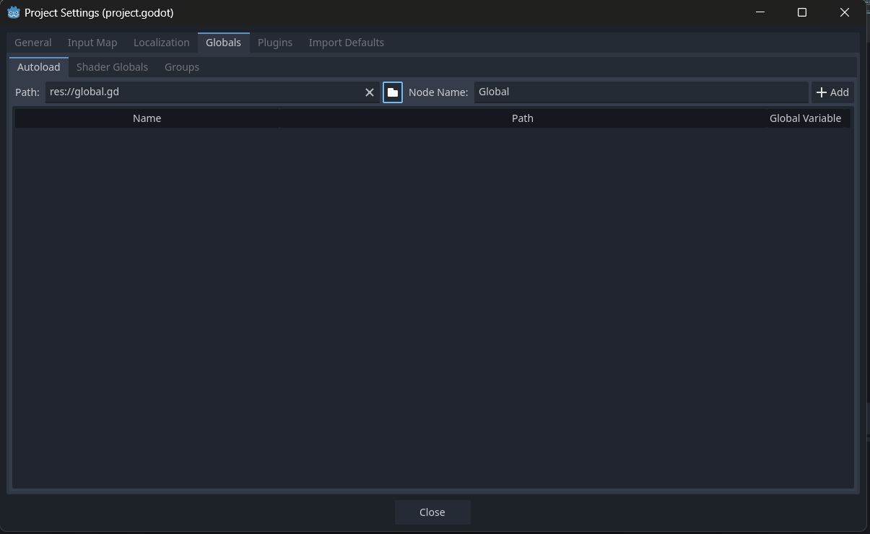
After that we just click Add button and that’s it! The script is now an Autoload!

Slide 29
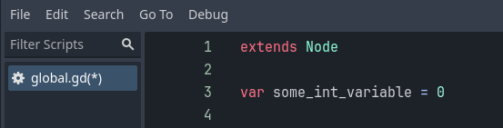
Autoload
Now in any script, we can call the Autoload script’s name (in this case called “Global”). But how?
We can define variables which can be accessed from any other script.

Slide 30
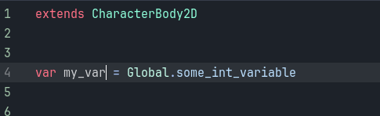
Autoload
And then we just call the Autoload and its variables as we wish!

Slide 31
Thanks!
Any Questions

